Slide 1
Design of RF & Microwave Systems
EEC 134 A&B
Lecture 1: Introduction through a Brief History of Radios
Xiaoguang “Leo” Liu
Assistant Professor
School of Electrical and Computer Engineering
Tel: 530-289-6367
lxgliu@ucdavis.edu
http://ucdart.net

Slide 2
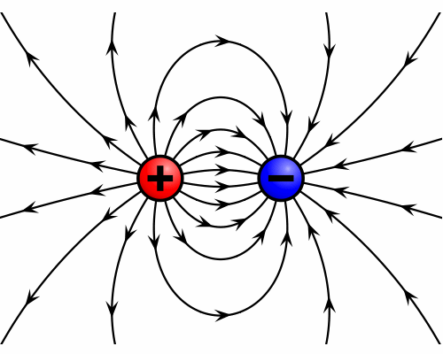
Electric Field

Slide 3
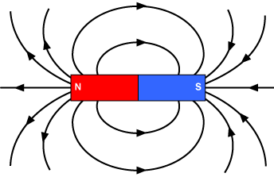
Magnetic Field

Slide 4
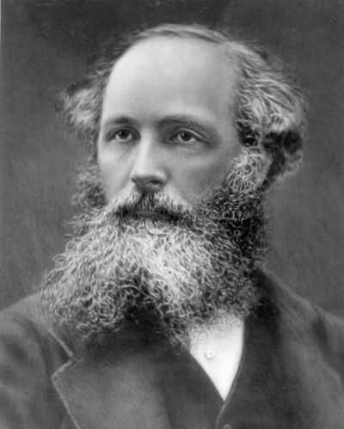
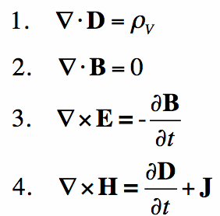
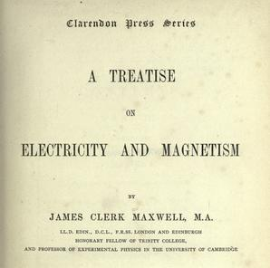
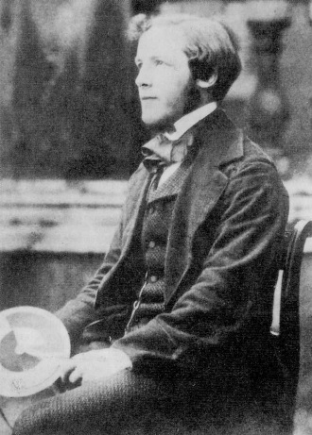
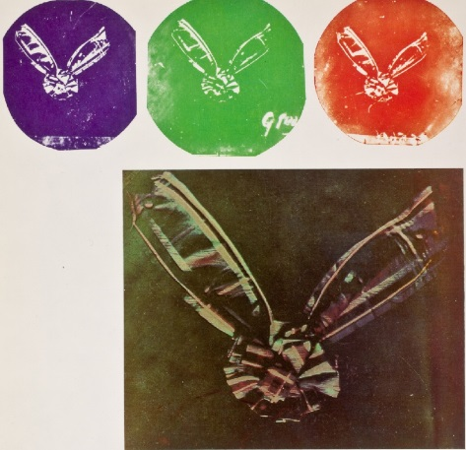
James Clerk Maxwell
The Maxwell’s Equations
Introduced the concept of “displacement current
Unified electric and magnetic theory
Predicted the electromagnetic wave
Also invented color photography and pioneered modern control theory

Slide 5
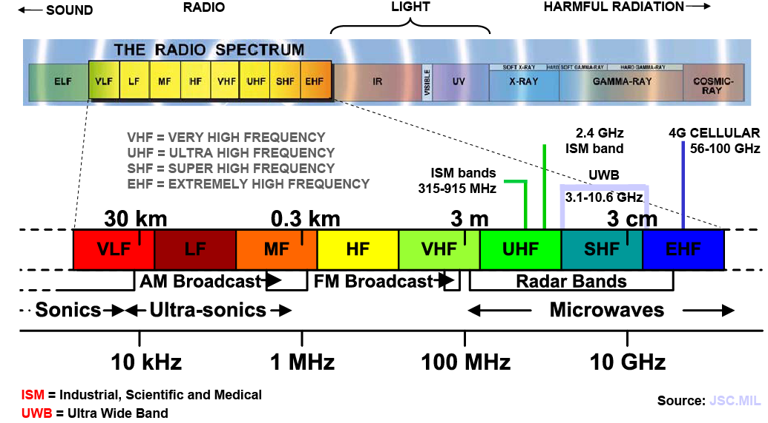
Electromagnetic Spectrum

Slide 6
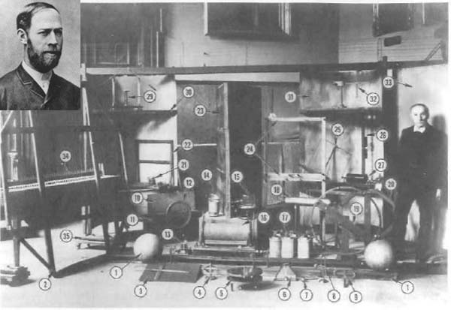
Heinrich Rudolf Hertz
Experimentally verified Maxwell’s theory of electromagnetic waves
By building a radio transmitter and receiver
Original Apparatus used by Heinrich Rudolf Hertz (February 22, 1857 – January 1, 1894) for his experiments to prove the existence of electromagnetic waves.
http://mouloudrahmani.com/electrical/rfmicrowave/RFMicrowaveHome.html

Slide 7
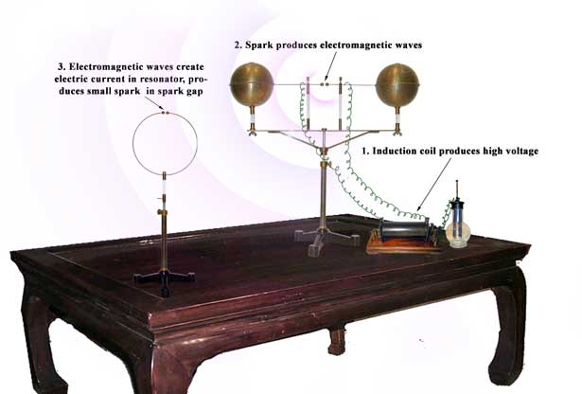
Hertz’s Experiment Set-up
Spark transmitter and receiver
Use high voltage to induce sparks between two closely placed electrodes
The sparks give off radio waves of a wide range of frequencies
Hertz’s experiment requires very high power to ignite the spark in the receiver
http://www.sparkmuseum.com/BOOK_HERTZ.HTM

Slide 8
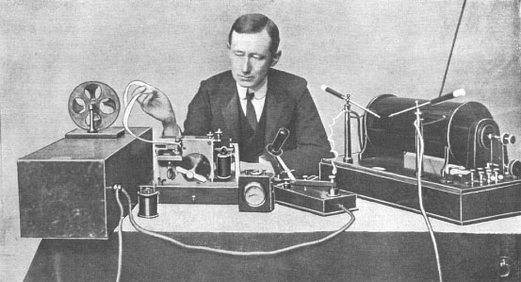
Guglielmo Marconi
Realized the potential of using radio waves for long range wireless communication
A very successful businessman
http://en.wikipedia.org/wiki/File:Marconi_at_desk.jpg

Slide 9
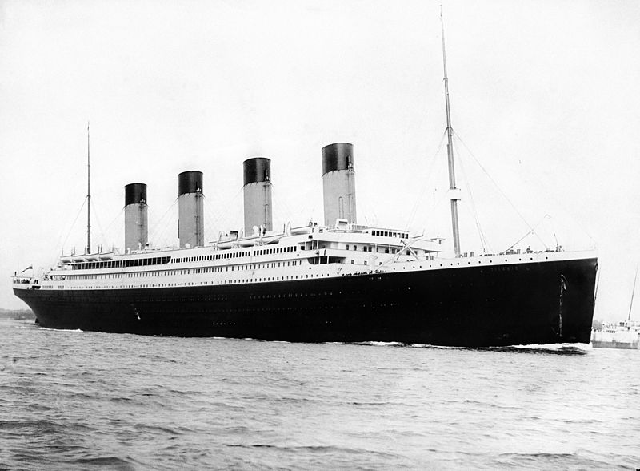
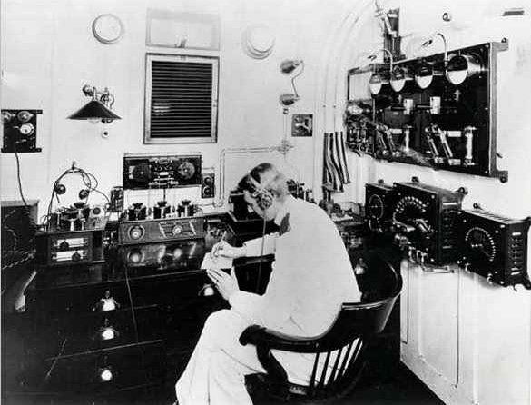
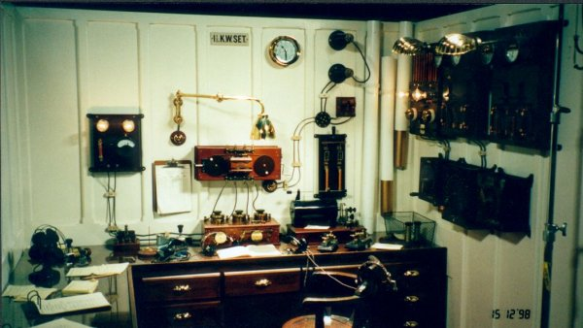
The Titanic
12:40 am, 15 April 1912 R.M.S. Titanic to R.M.S. Carpathia: "SOS Titanic sinking by the head. We are about all down. Sinking. . ."
http://www.hf.ro/

Slide 10
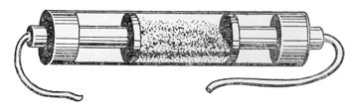
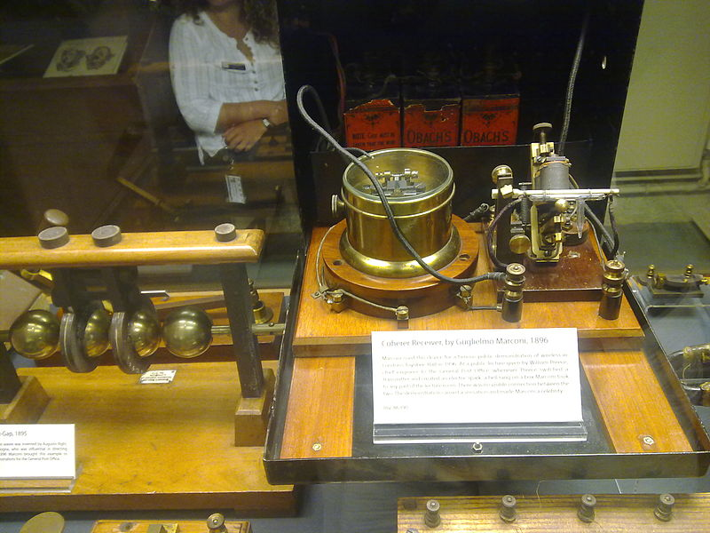
The Coherer
The invention of the coherer allows weak signals to be detected
The coherer consists of a tube filled by metal filings, and two electrodes contacting the metal filings
Radio waves causes the conductivity between the electrodes to decrease
Unfortunately, it only works once!
The exact working principles of coherer is still not known
The radioconductor or coherer was invented in 1890 by the French physicist Edouard Branly
Marconi's 1896 coherer receiver, at the Oxford Museum of the History of Science, UK. The coherer is on right, with the decoherer mechanism behind it. The relay is in the cylindrical metal container (center) to shield the coherer from the RF noise from its contacts.
http://www.historywebsite.co.uk/Museum/Engineering/Electronics/history/earlytxrx.htm
http://en.wikipedia.org/wiki/Coherer
Notes:
Simple Homemade Coherer: http://www.sparkbangbuzz.com/els/coherer-el.htm
Coherer(Wikipedia): http://en.wikipedia.org/wiki/Coherer

Slide 11
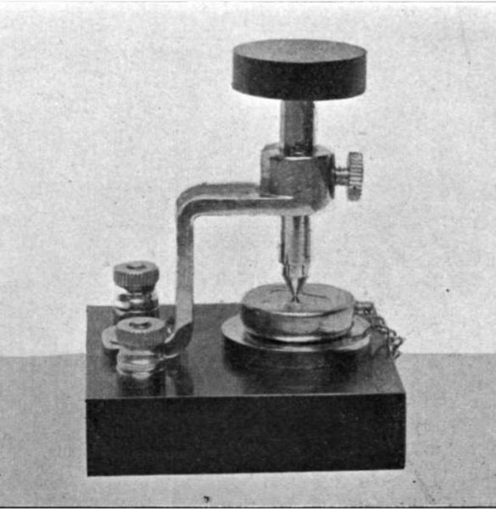
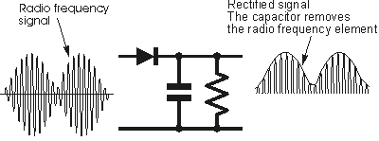
Crystal Receiver
Also known as “crystal set” or “cat’s whisker detector”
Relies on the rectifying contact between metal and certain crystalline minerals, such as galena; today we know this as a diode
Very simple and inexpensive to construct: antenna wire, tuning coil, capacitor, a crystal, and earphones
No batteries needed
It’s a passive detector; meaning it doesn’t require external power
Also means that there is no amplification of the signal
Range is rather limited; or else you’d have send tons of power at the transmitter
Greenleaf Pickard’s silicon crystal receiver
http://commons.wikimedia.org/wiki/File:Silicon_crystal_detector.jpg

Slide 12
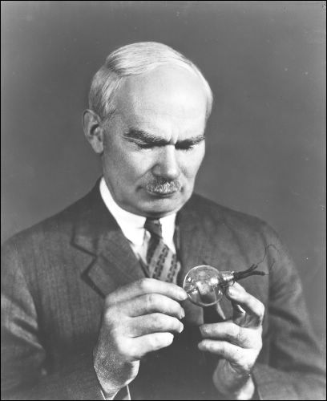
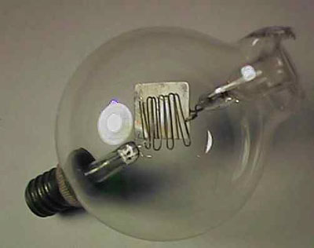
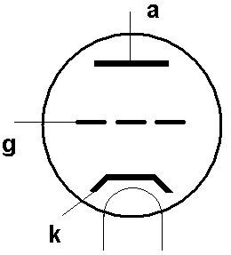
The Audion
In 1907, Lee de Forest invented the “audion”, the first vacuum tube device
The device was based on a phenomena observed by Thomas Edison:
when a correct polarity of voltage is applied between the hot filament and an electrode inside a light bulb, a current can be measured; this is now known as “thermionic emission”
De Forest added another plate inside the bulb and was able to use it to control the current flow
De Forest invented by tinkering and it was apparent he didn’t understand how the device actually worked!
De Forest coined the term “radio”; he didn’t like “wireless”…
http://en.wikipedia.org/wiki/Lee_de_Forest
http://uv201.com/Tube_Pages/deforest_audion.htm
http://earlyradiohistory.us/1907aud.htm
http://historysanjose.org/wp/research-collection/collections/the-perham-collection/the-people/lee-de-forest/

Slide 13
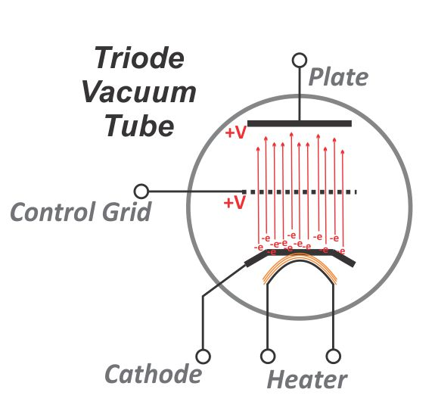
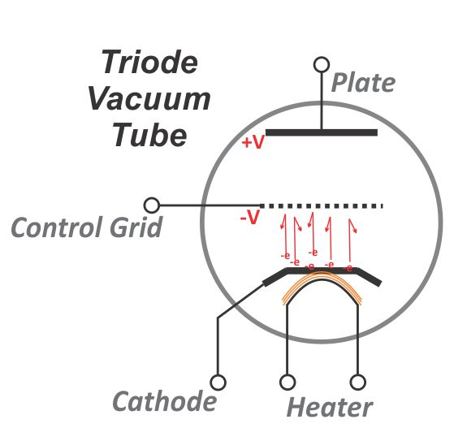
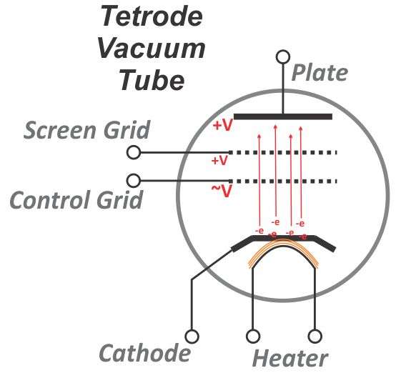
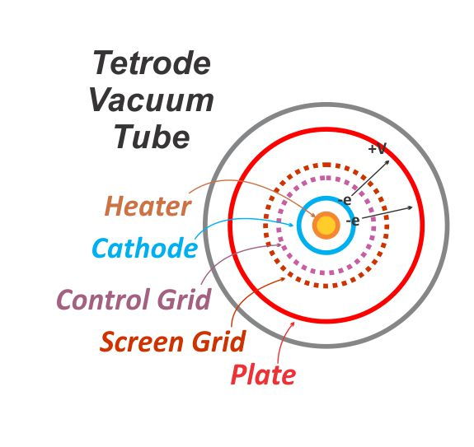
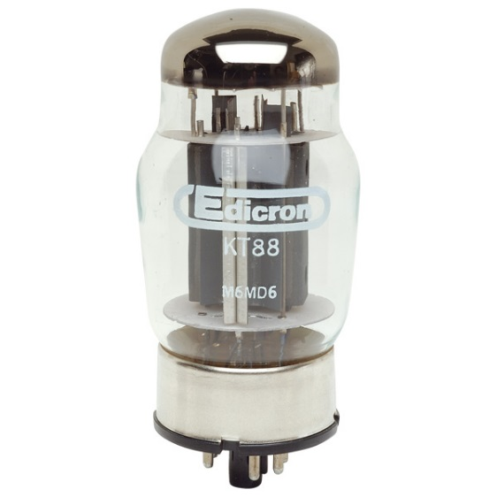
The Audion – The Triode and the Tetrode
Allows a weak voltage signal to control a stronger current → signal amplification
http://www.hamradioschool.com/g6b10-vacuum-tubes/
http://www.rapidonline.com/electronic-components/kt88-tetrode-valve-35365
Notes:
Schematic of the triode; show some amplifier circuits; explain why gain is low

Slide 14
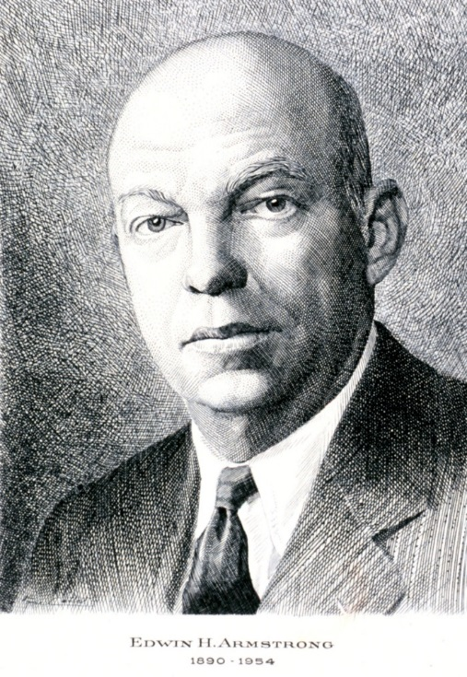
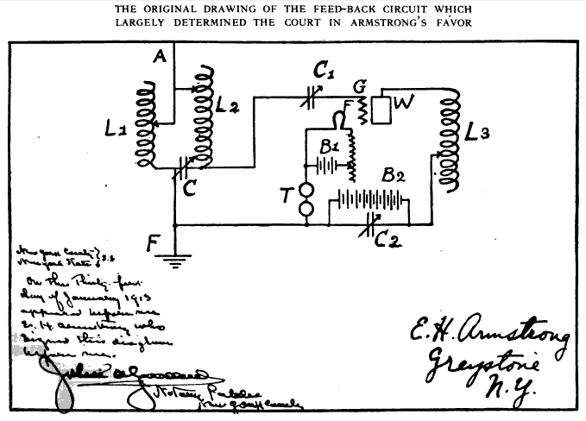
Edwin Howard Armstrong
The audion was initially used as a diode in a receiver; it was very popular and essentially replaced the coherers and crystal radios
The use of audion to amplify signals was invented by Edwin Howard Armstrong, a name that you should remember if you major in RF/microwave engineering; he essentially invented most of the high frequency techniques we use today.
The original drawing of Edwin Armstrong’s “regenerative” circuit
http://en.wikipedia.org/wiki/Edwin_Armstrong

Slide 15
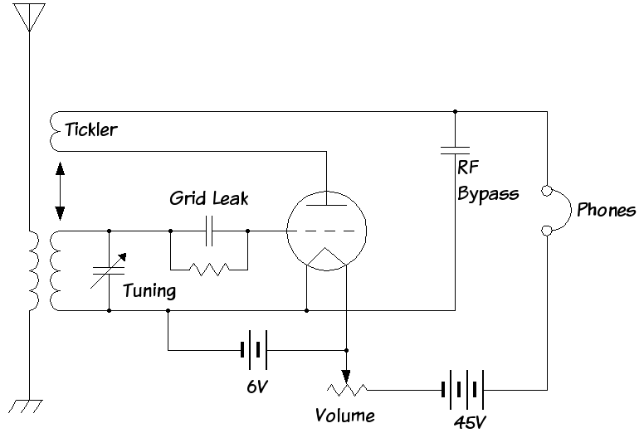
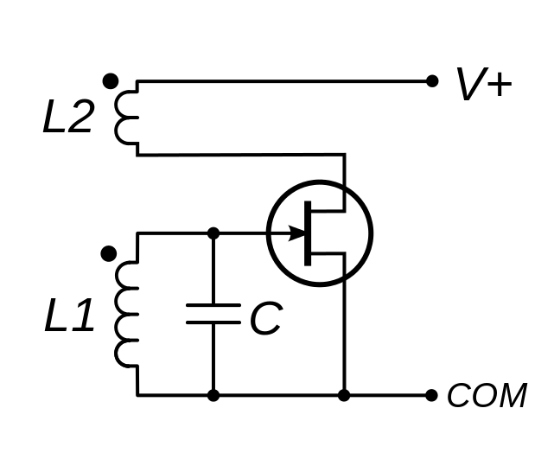
Edwin Howard Armstrong
Born in 1890; became interested in radio technologies at an early age
Invented regeneration (amplification by positive feedback) while in college
At the same time, he also observed high frequency oscillation of the signals if the feedback is made stronger; thus inventing an oscillator which could be used to generate strong signals for radio transmitters
These two inventions paved way for continuous wave (CW) radio communications, which very soon took over “spark”-based radios
Feedback
http://en.wikipedia.org/wiki/Armstrong_oscillator
http://en.wikipedia.org/wiki/Regenerative_circuit

Slide 16
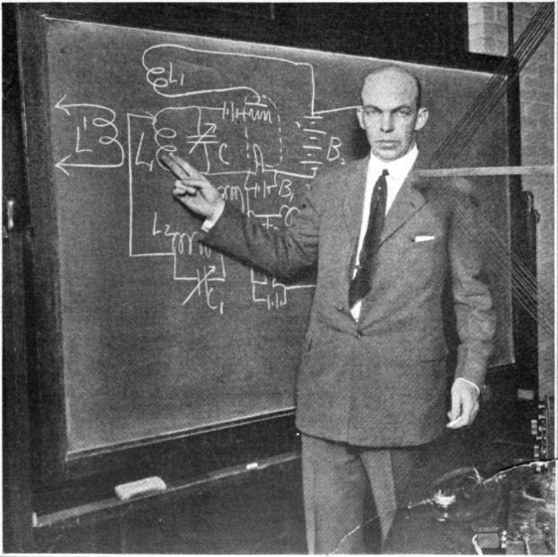
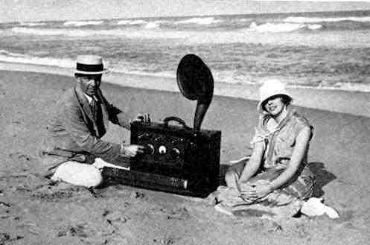
Edwin Howard Armstrong
Armstrong joined both WWs, and allowed the US Military to use his patents for free
In 1918, during WW-I, he invented the superheterodyne receiver; which is still used in most of today’s radios
In 1922, he invented the super-regenerative receiver, which today finds applications in simple low-cost radio remote controls
In 1935, he invented the frequency modulation (FM) radio
Armstrong made profound contributions to radio technologies; but he was not a successful businessman
Committed suicide in 1954
Armstrong explaining the super-regenerative receiver, New York, 1922
Armstrong and his new wife Esther Marion MacInnis in 1923. The radio is a portable superheterodyne that Armstrong built as a present for her.
http://en.wikipedia.org/wiki/Edwin_Howard_Armstrong

Slide 17
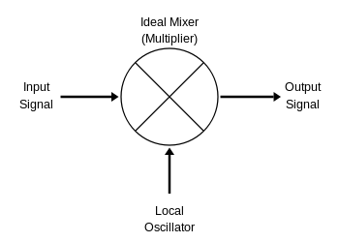
Superheterodyne Receiver – Heterodyne
Let’s start with “heterodyne”
“Heterodyning is a radio signal processing technique popularized by Canadian inventor-engineer Reginald Fessenden in 1901, in which new frequencies are created by combining or mixing two frequencies.”
“The two frequencies are combined in a nonlinear signal-processing device such as a vacuum tube, transistor, or diode, usually called a mixer. In the most common application, two signals at frequencies f₁ and f₂ are mixed, creating two new signals, one at the sum f₁ + f₂ of the two frequencies, and the other at the difference f₁ − f₂. These new frequencies are called heterodynes. Typically only one of the new frequencies is desired, and the other signal is filtered out of the output of the mixer.”
f₁ + f₂
f₁
f₁ − f₂
f₂

Slide 18
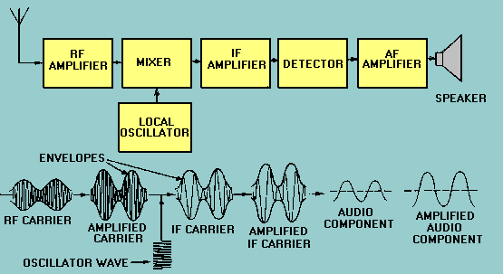
Superheterodyne Receiver
Move the incoming RF signal to a much lower frequency for detection
It is easier to build detectors at lower frequencies
It is easier have gain at lower frequencies
Gain can also be distributed across different frequencies to avoid oscillation
Great performance

Slide 19
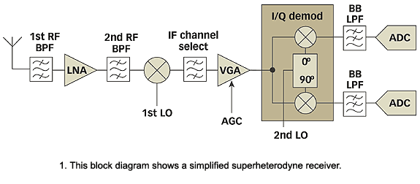
Superheterodyne Receiver
Block diagram with a more modern look
Principles are still the same
http://mwrf.com/components/quad-demodulators-arm-direct-conversion-receivers

Slide 20
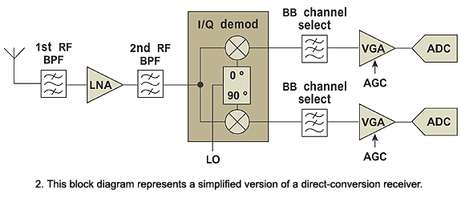
Homodyne (Direct Conversion) Receiver
There is no IF, move the RF signal to base-band directly
A very flexible architecture
There are number of technical issues initially; was not very popular for a longtime
Recently development in integrated circuit technologies has largely revived this architecture

Slide 21
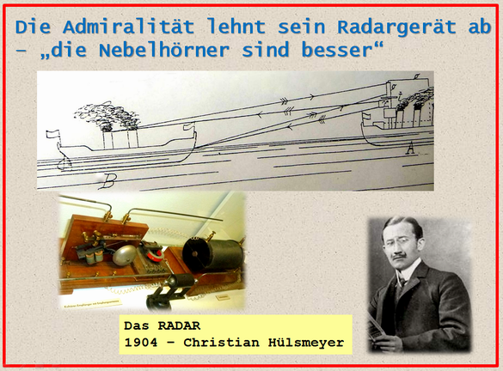
RADAR – RAdio Detection And Ranging
Hertz was aware that electromagnetic waves can bounce off solid objects
Patents on using radio waves to detect the presence of distant metallic objects were filed by German inventor Christian Hulsmeyer circa 1904 in Germany and Great Britain
http://heureka-stories.de/Inhalt

Slide 22
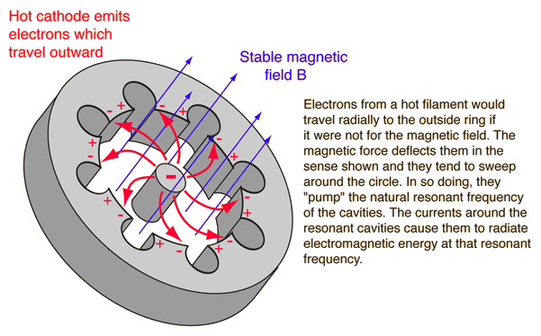
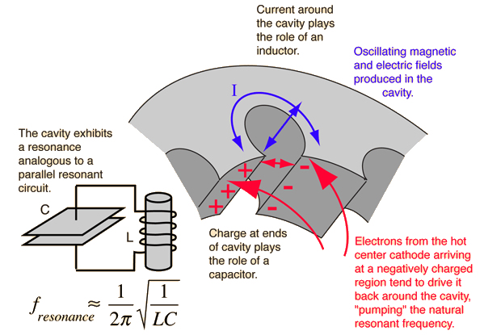
The Magnetron
The invention of the magnetron by John Randall and Harry Boot in 1940 at the University of Birmingham, England, made it possible to generate very high power coherent radiation at microwave frequencies
This finally made radar technologies practical for warfare
http://hyperphysics.phy-astr.gsu.edu/hbase/waves/magnetron.html
http://microwavetubes.iwarp.com/How_Magnetron_Work.html

Slide 23
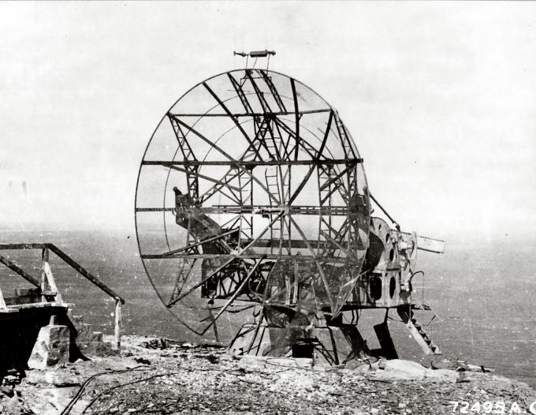
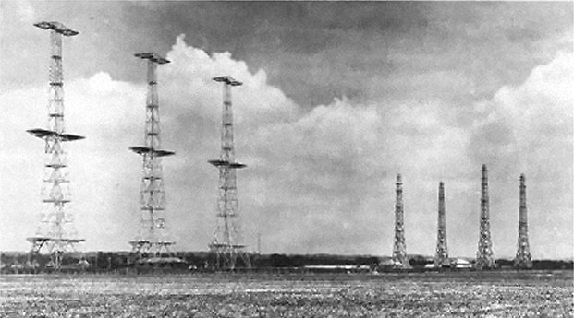
RADAR
Several nations started research on radar technologies before WWII; the term RADAR was coined by US Navy in 1940
Military use was the main driving force for radar development
British: Chain Home radars
Germany: mid-war ground radar station FuMO 214 Würzburg-Riese
Deflating British Radar Myths of World War II
http://spitfiresite.com/2010/04/deflating-british-radar-myths-of-world-war-ii.html/6

Slide 24
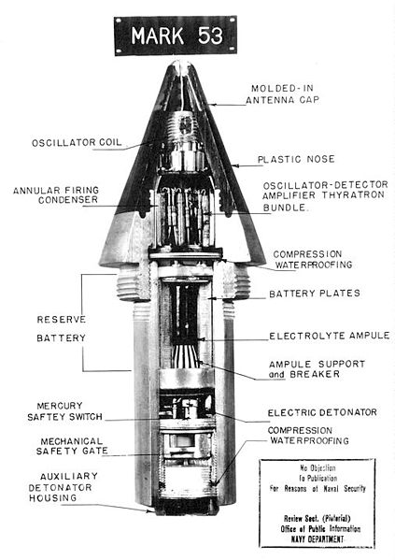
Proximity Fuse
Radio proximity fuse developed by the Applied Physics Laboratory during WWII
Arguably the simplest radar
Further reading: http://www.history.navy.mil/faqs/faq96-1.htm
http://www.jhuapl.edu/aboutapl/heritage/fuze/default.asp

Slide 25
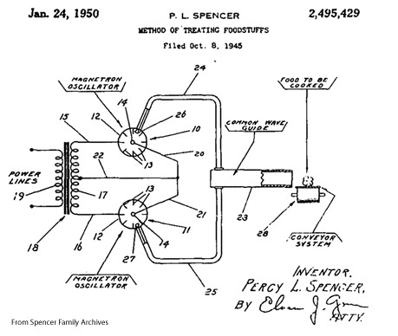
Microwave Ovens
Invented by Percy L. Spencer, vice president of Raytheon, in 1945

Slide 26
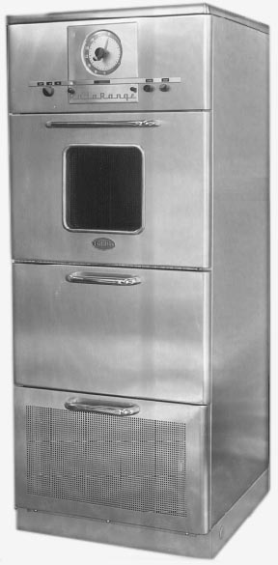
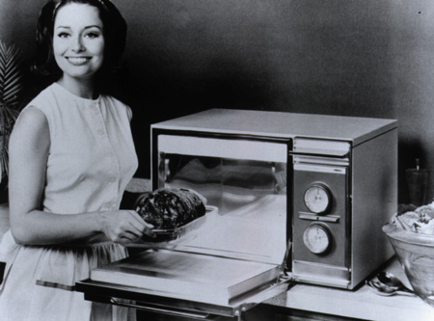
Microwave Ovens
The first microwave ovens were called “Radarange”…
Weighted 750 lbs
Not a commercial success until the 60s, when they became much smaller with the invention of a new generation of magnetron sources
http://www.marketingvp.com/guests/globe/oven.htm
http://www.smecc.org/microwave_oven.htm

Slide 27
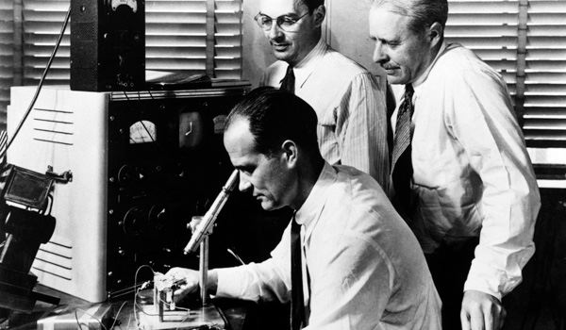
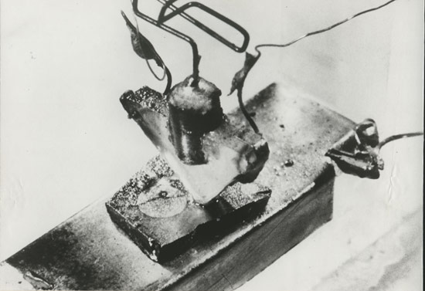
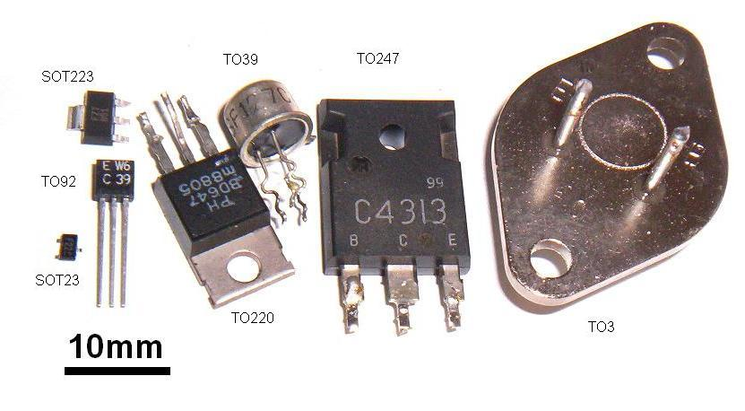
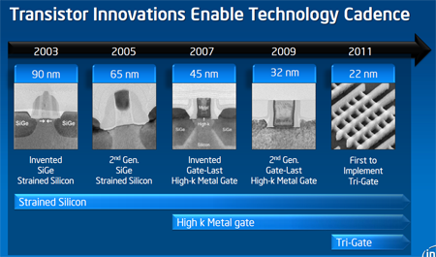
The Transistor
In 1947, William Shockley (seated), John Bardeen (center), and Walter Brattain (right) invented the transistor
This probably advanced the pace of human civilization by a few orders of magnitude
They went on to win the Nobel Prize in 1956
The first transistor as it was patented
http://www.zdnet.com/blog/computers/why-intels-22nm-technology-really-matters/5703
http://en.wikipedia.org/wiki/Transistor

Slide 28
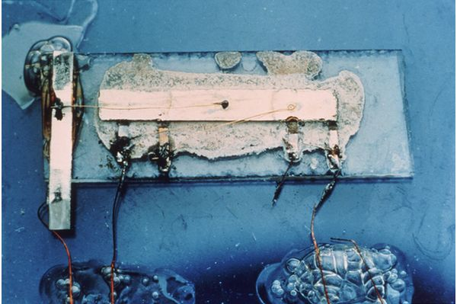

Integrated Circuits
Jack Kilby, 1958
How many transistors?
Intel i7 3.4 GHz, 2012
How many transistors?

Slide 29


Vacuum Tube vs. Transistor
8.47 x 10.50 mm
ENIAC
18,000 vacuum tubes
0.1 MHz
Intel Xeon E5-2600 V3
5,500,000,000 transistors
~1.4 GHz/core
http://wccftech.com/intel-xeon-e52600-v3-haswellep-workstation-server-processors-unleashed-highperformance-computing/1

Slide 30


RF/Microwave Integrated Circuits
In a similar way as you put digital logic into the form of an IC, RF and microwave circuits can also be integrated
Both silicon and more exotic materials are used
GaAs, mature, high frequencies
GaN, emerging, high power
InP, maturing, extremely high freq.
Silicon, mature, low/high power, low cost, high freq.

Slide 31



Radio Frequency Integrated Circuits
Today’s silicon IC technologies are extremely fast
Consider, your Intel i7s are running at a clock rate of close to 4 GHz; that’s higher than the RF carrier frequency of your cellphones; also higher than the high power microwaves in a microwave oven
65nm CMOS transistor can now generate frequencies up to 300 GHz (over 1,000 GHz if harmonics are used)
Today’s silicon ICs also have extremely high density
You can now implement entire RF/microwave systems on a single chip of tiny area
The availability of vast amount of digital circuits makes it possible to realize new circuit/system architectures a

Slide 32


RF System on Chip
Complete wireless communication transceiver on a single chip
Complete radar system on a single chip, even with the antenna

Slide 33




Realization of RF/Microwave Systems
PCBs with Integrated Circuits (IC)
RF IC suppliers
Skyworks
Analog Devices
RFMD
Freescale
Triquent
Hittite Microwave
…
Skyworks
Analog Devices
http://www.microwavejournal.com/articles/8334-two-stage-ultra-low-noise-amplifiers

Slide 34


Realization of RF/Microwave Systems
RF/microwave PCBs
With discrete transistors

Slide 35



So are Vacuum Tubes Dead?
Vacuum tubes and waveguides
AN/FPS-50 Detection Radar

Slide 36


Wireless Communication
4.5 million cell phones sold every day
7 trillion text messages sent in 2011
1987
2014

Slide 37





Communication
TV and radio broadcast
Wireless cellular networks
Microwave point-to-point links
Walkie-talkies
Images taken from the Internet

Slide 38

Communication System
Receive
Transmit
Image taken from Analog Device Website

Slide 39

Radar
Transmit
Receive
Read more: http://mil-aero.analog.com/en/radar/segment/ma.html

Slide 40




Radio Astronomy
See the universe in radio waves (vs. visible light)
Map of the Cosmic Microwave Background (CMB) at 160.2 GHz
Credit: NASA
Very Large Array (VLA)
radio telescope

Slide 41




RF/Microwave Test Equipment
Vector Network Analyzer
Spectrum Analyzer

